Slide 1

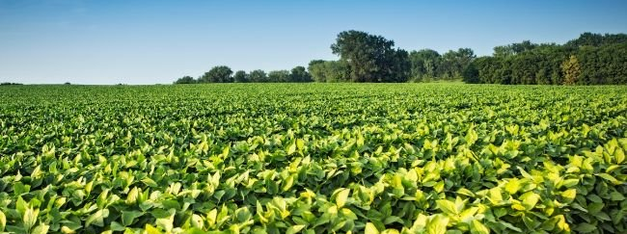
Leveraging machine learning models and multi-environmental soybean trial data for environmental characterization and genomic prediction in Argentina.
Carlos Hernandez
Final Project – AGRON920

Slide 2


Objectives
Delineate agro-environmental zones in the soybean production region in Argentina.
Train a machine learning model using environmental and crop data to predict soybean seed yield

Slide 3
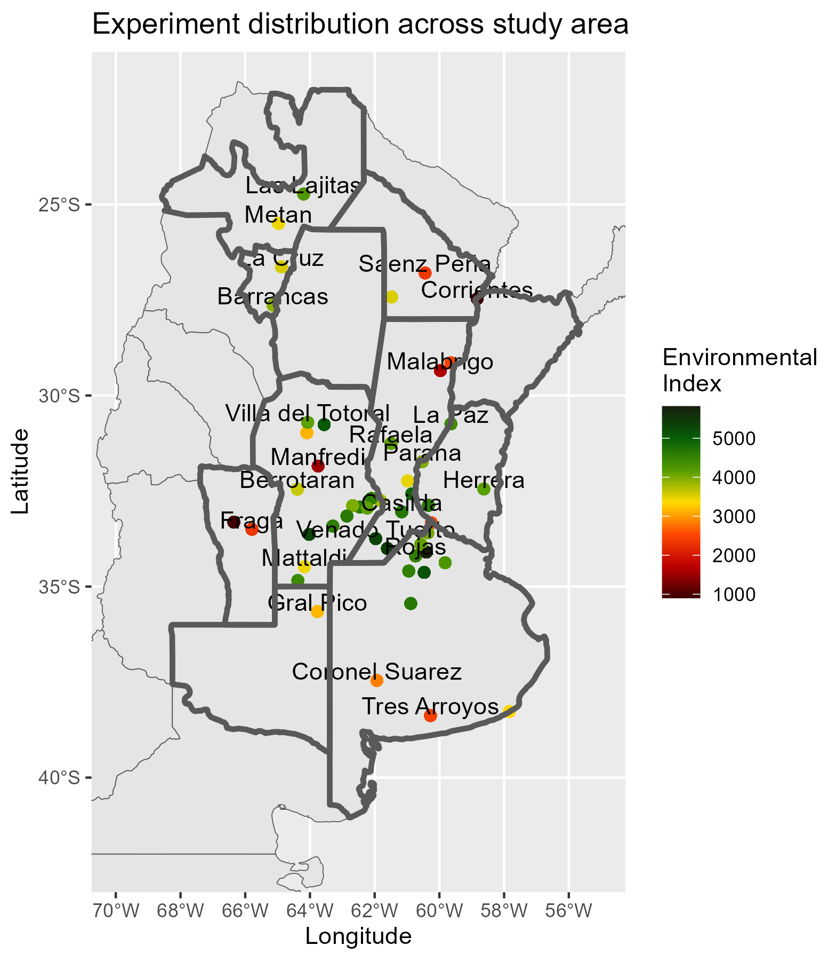
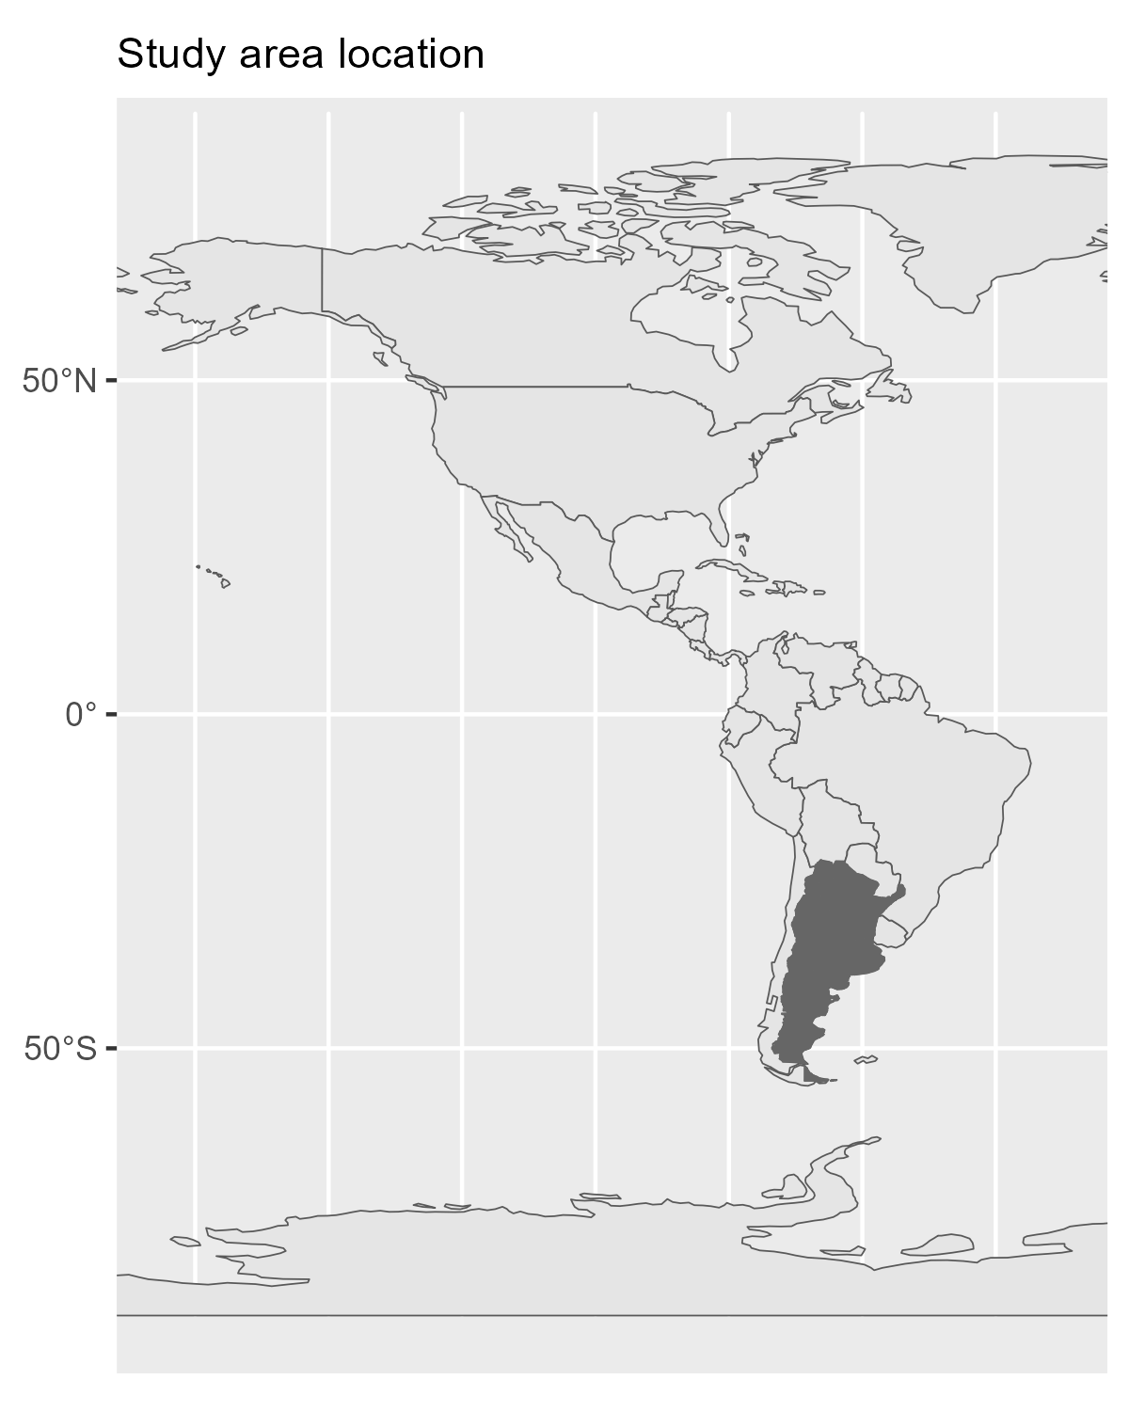
Materials and methods
Study Area

Slide 4
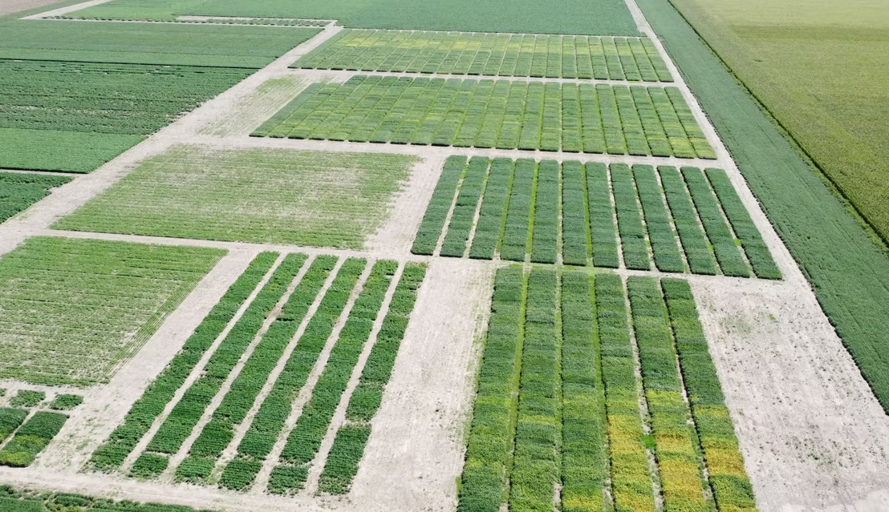
Materials and methods
Multi environmental trial network data description (RECSO INTA)
Randomized complete block design with 3 repetitions
Seasons :
2023/2024
22 Sites
114 varieties
9 maturity groups

Slide 5
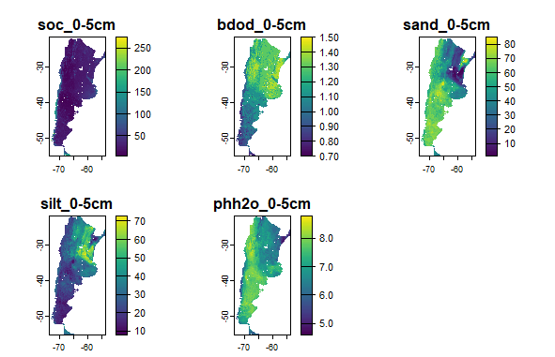
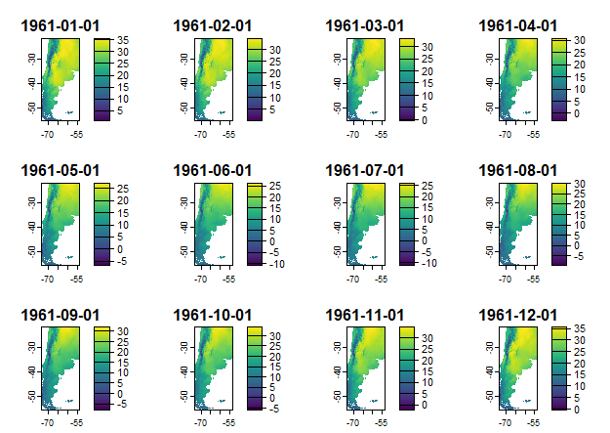
Materials and methods
Climate and soil data description
Soil variables: Soilgrids
SOC
Bulk Density
Sand
Silt and
pH
Climate variables: Terraclimate normals
Temperature min.
Temperature max.
Actual et (Aet)
Precipitation (ppt)
Vapor pressure deficit (vpd)
Soil data
Climate data

Slide 6
Materials and methods
Spatial Principal component and clustering analysis
The loadings of a common PCA are affected by spatial autocorrelation.
Capture more variability when the data has higher spatial autocorrelation
Spatial clustering produce smoother clusters maps
Optimal number of clusters will be defined by clusters indexes
Data integration
Spatial Principal component analysis
Spatial Clustering analysis

Slide 7




Materials and methods
Predictive modelling
Model: Random forest
Train test split: 70/30 with stratification by clusters
Cross validation: k-fold with 5 folds and 3 repetitions
RMSE will be used as a selection criterion to obtain the best model
Hyperparameter tuning
Mtry
Trees
Min-n
Training dataset (70%)
Predictive performance
Soil data
Crop data
Testing dataset (30%)
Climate data

Slide 8
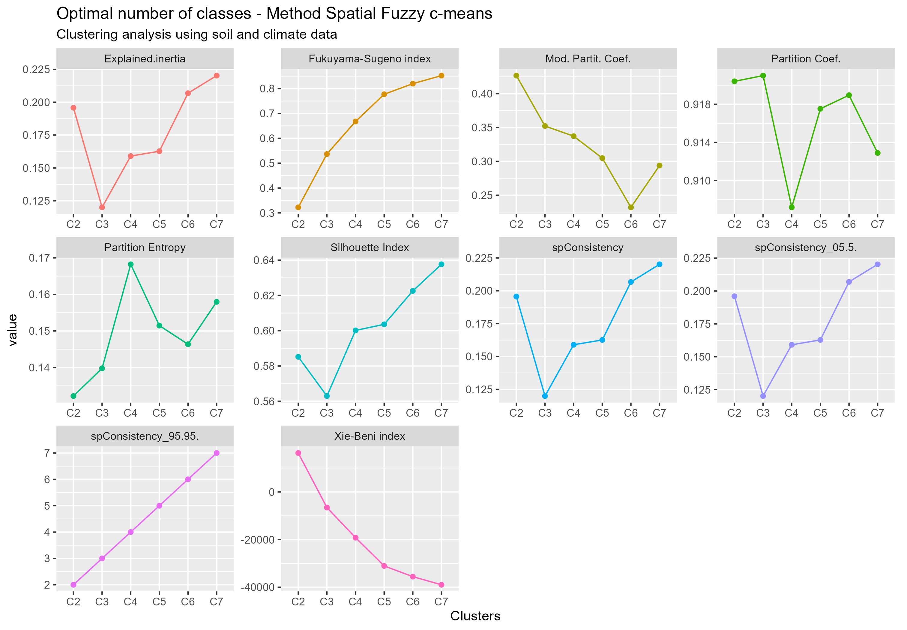
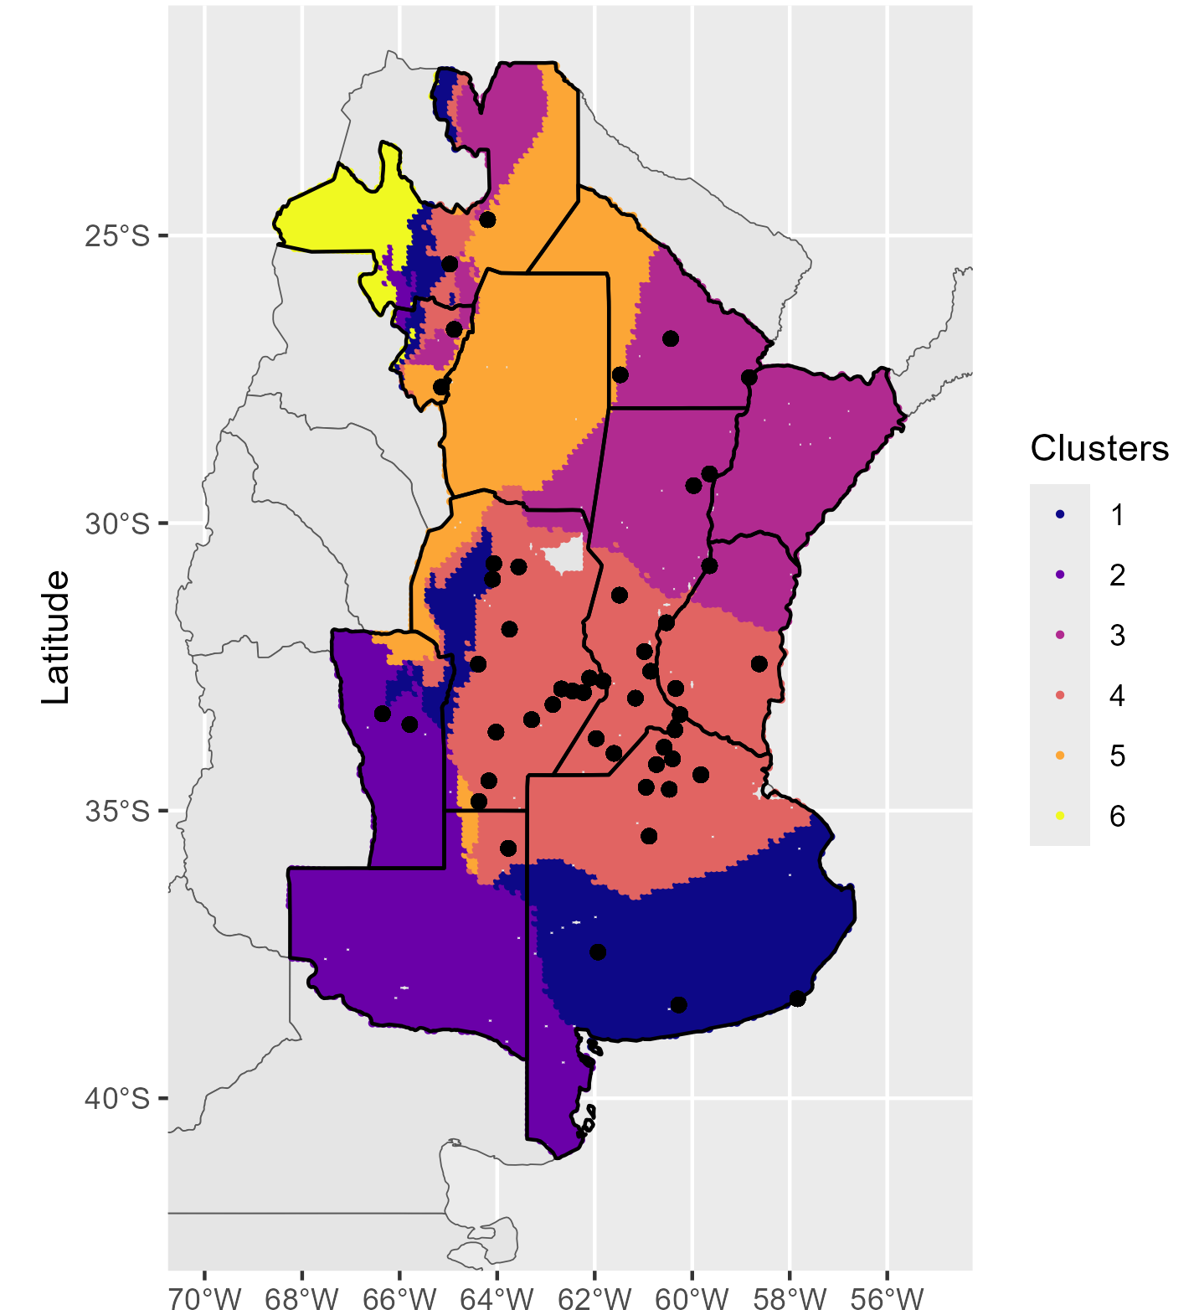
Results
Principal component and clustering analysis

Slide 9
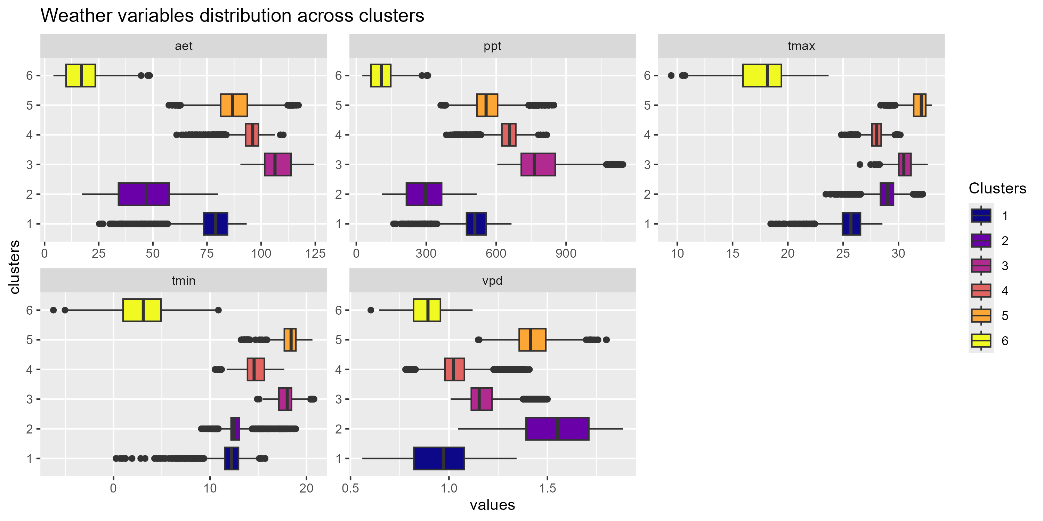
Results
Cluster weather characterization

Slide 10
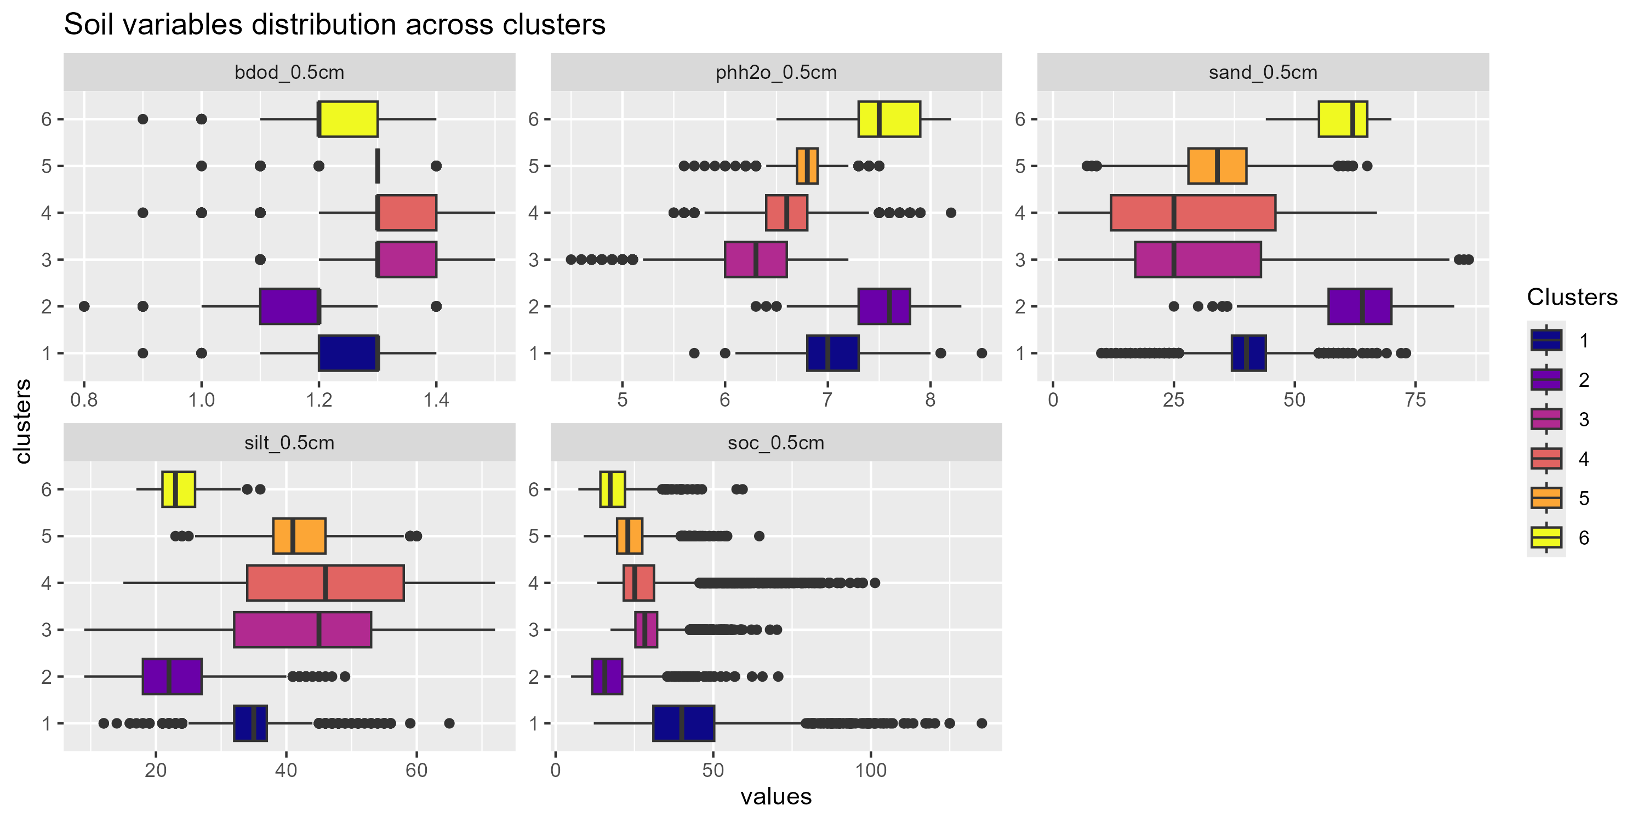
Results
Cluster soil characterization

Slide 11
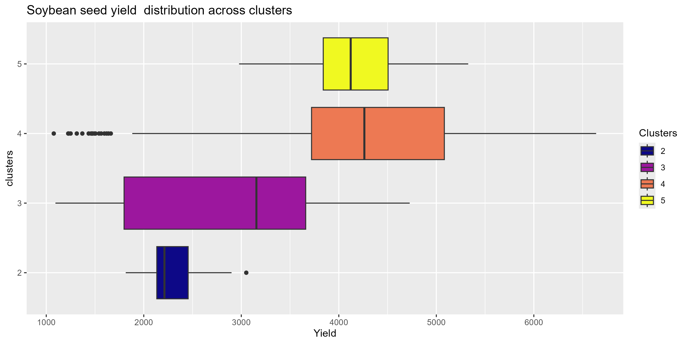
Results
Cluster crop characterization

Slide 12
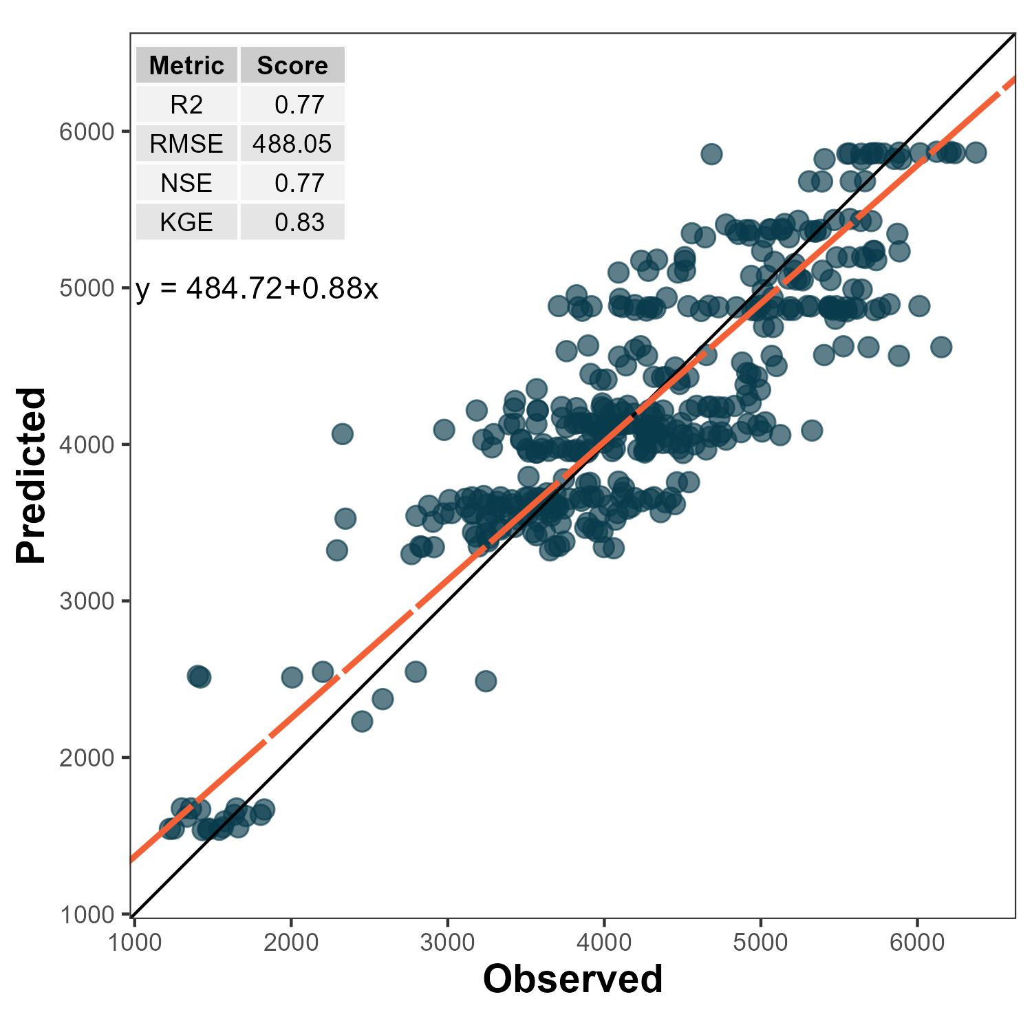
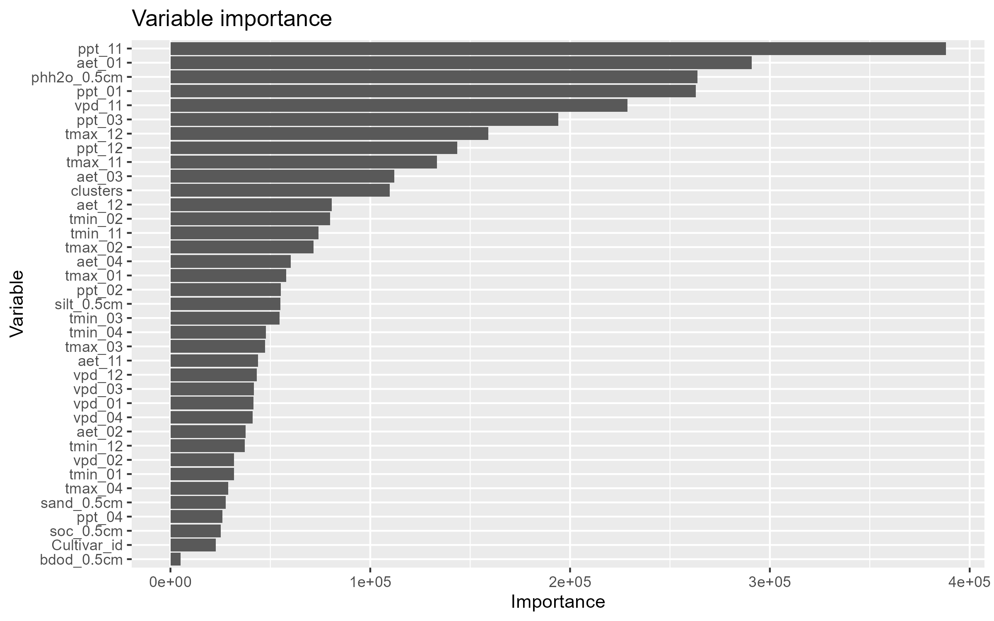
Results
Predictive performance and variable importance

Slide 13
Take home messages
The soybean production region region can be delineated in 6 environmental zones considering climate and soil patterns.
The environmental zones showed large differences in both soil and climate variables.
The cluster (zone) 4 showed the highest levels of yields and the cluster 2 the lowests. The cluster zone has higher temperature and precipitation than 2, with also better soil features.
The trained model successfully predict the soybean seed yield with a R2 of 0.77 and a RMSE of 488 kg.Ha-1

Slide 14

Thanks!
Do you have any questions?

